Slide 1
Smart Energy Management
SMART SOLAR MONITOR

Slide 2
Contents
01
02
03
Solution Overview
Key Benefits
Introduction
04
05
06
Features
Visualization
Tech Stack

Slide 3
INTRODUCTION
Streamlining Solar Plant Monitoring: The Smart Solar Plant Monitoring System is an innovative software solution designed to streamline the monitoring and management of solar power plants.
Automated Data Collection and Analysis: The software system automates the collection of data from various sources within the solar plant, including energy production, weather conditions, and system performance. It then applies advanced analytics algorithms to provide valuable insights for optimal plant management.
Real-time Monitoring and Alerts: The software enables real-time monitoring of key performance indicators, such as energy production, power generation efficiency, and system health. It provides instant alerts and notifications for any deviations or issues, allowing prompt corrective actions to be taken.
Centralized Data Management: The software offers a centralized data management platform, allowing solar plant operators to access and analyze critical data from a single interface. This eliminates the need for manual data consolidation and enables efficient reporting and decision-making.
Intelligent Solar Panel Adjustment: The software incorporates intelligent algorithms to dynamically adjust the positioning of solar panels based on the sun's position. This ensures optimal exposure to sunlight throughout the day, maximizing energy generation and plant efficiency.
Advanced Reporting and Visualization: The software provides comprehensive reporting and visualization tools to present the collected data in a clear and actionable manner. It offers intuitive dashboards, charts, and graphs that facilitate data interpretation, performance analysis, and identification of optimization opportunities.

Slide 4
PROBLEM STATEMENT
In many parts of India, data collection for electricity consumption still relies on manual methods, leading to various challenges and limitations:
Manual data collection has drawbacks: In cases where nobody is present during the visit, the current month's electricity consumption gets coupled with the previous month's, resulting in inaccurate billing and potentially higher costs.
Infeasibility during critical situations: Manual data collection becomes challenging during crises such as the Covid-19 pandemic, preventing accurate monitoring and billing.
Lack of awareness and education: Many citizens are unaware of energy-saving practices, hindering their ability to make informed decisions and reduce electricity wastage.
The need for automation: By automating the data collection process and employing smart energy-saving techniques, households can potentially save 15-20% of their monthly electricity costs.

Slide 5
SOLUTION OVERVIEW
IoT-enabled Solar Monitoring: Utilize IoT sensors to collect real-time data on solar irradiance, panel temperature, and power output for accurate monitoring.
Dynamic Panel Alignment: Implement a microcontroller, LDR sensors, and a stepper motor to dynamically adjust panel orientation for optimal sunlight capture.
Cloud-based Data Analysis: Transmit collected data to a cloud platform for real-time analysis using advanced algorithms.
Intelligent Power Management: Employ machine learning models to predict energy consumption and optimize power usage.
User-Friendly Interface: Provide a mobile app and web dashboard for users to monitor performance, track energy production, and visualize data.

Slide 6
Key benefits
15%
20%
15%
Maximize solar potential.
Improved performance, higher yields.
Efficient management, reduced expenses.

Slide 7
Features
Monitoring Energy Consumption
Setting Energy Conservation Goals
Visualization of Energy Consumption data
Alerts and Notifications
Calculate and reduce your Electricity Bills

Slide 8
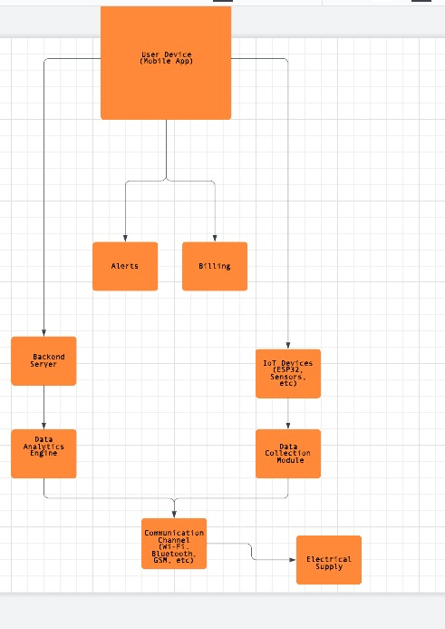
Deployment level diagram of problem.

Slide 9
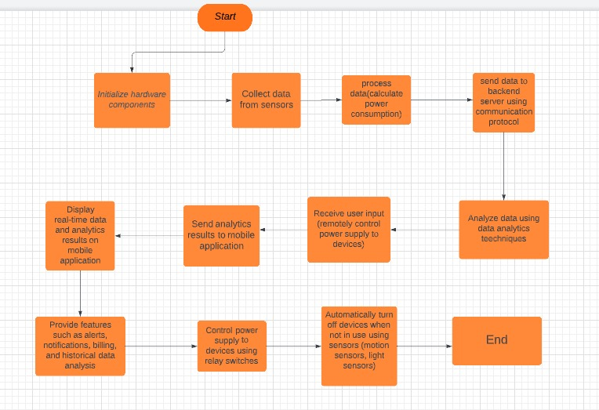
Flowchart of the software process

Slide 10
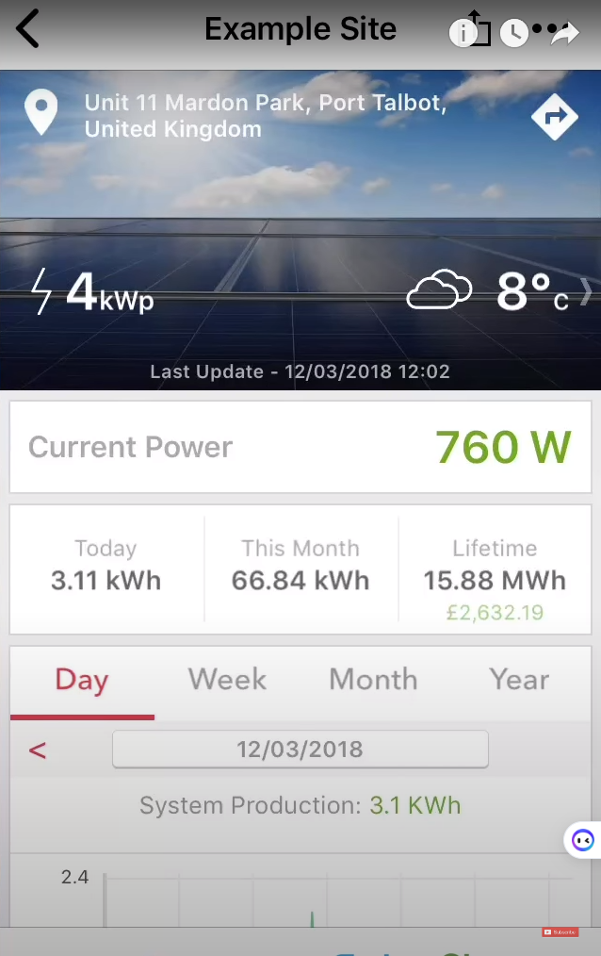
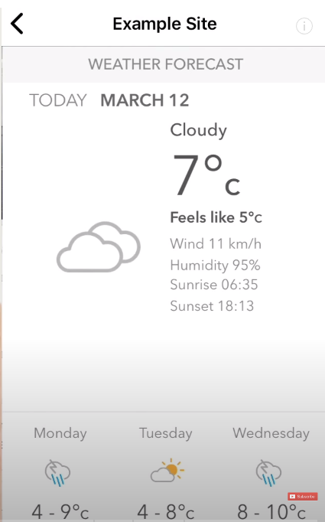
Application design with UI design (all web pages)

Slide 11
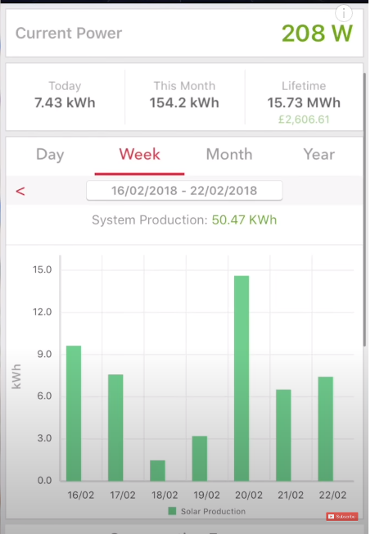
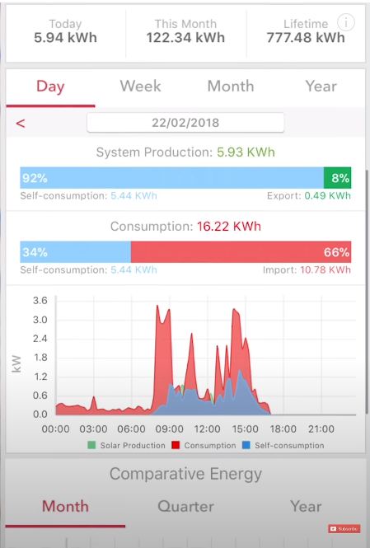
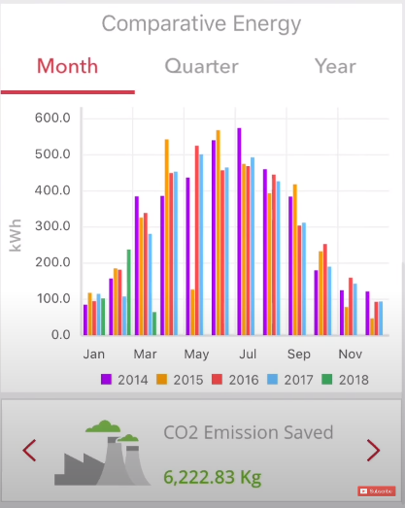

Slide 12
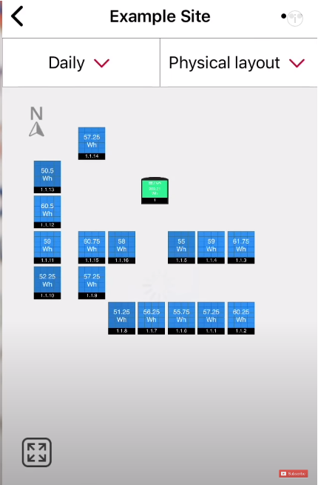
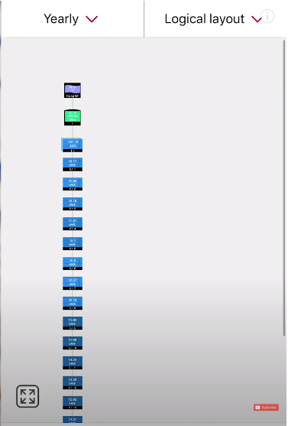

Slide 13

Demo Video

Slide 14
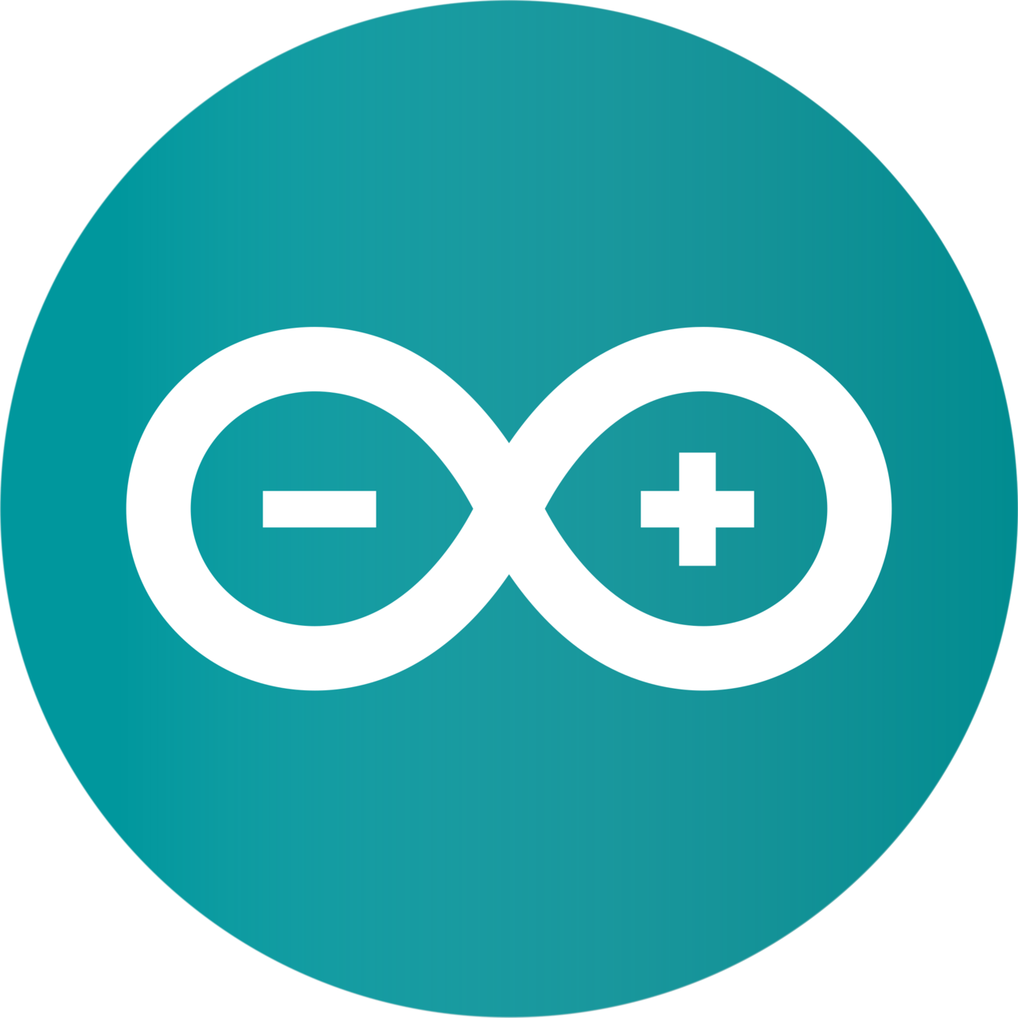

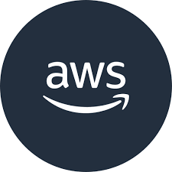

TECH STACK
Arduino: We Intend on Using Arduino IDE and ESP32 microcontroller for controlling the sensors and the display in the smart monitor.
AWS: We intend on using AWS as our cloud backend. It will be used to store and analyse the data sent from the smart meter. It is also used to send insights to the user’s app.
Blynk App: The Blynk app is used by the customer to control his devices remotely, view historical and live data analysis and calculate his Electricity Bill.

Slide 15
Budget for Case study prototype building:
Budget for Hardware components and sensors:
ESP32 Microcontroller: INR 500
ACS712 Current Sensor: INR 200
ZMPT101B Voltage Sensor: INR 120
JHD162A LCD DISPLAY: INR 250
Relay Module: INR 150
Breadboard: INR 50
Resistors and Connecting Wires: INR 50
Cloud Services: We can use free hosting services like Render or Heroku. Or Else we can make use of the $100 free credits provided by AWS.

Slide 16
THANK YOU!!!
TEAM MEMBERS
Praveen Kumar M | CB.EN.U4CSE20449
Pradeep Karthik M | CB.EN.U4CSE20447
Maheshvar J P | CB.EN.U4CSE20436
Guruprasad K S | CB.EN.U4CSE20421

